Slide 1
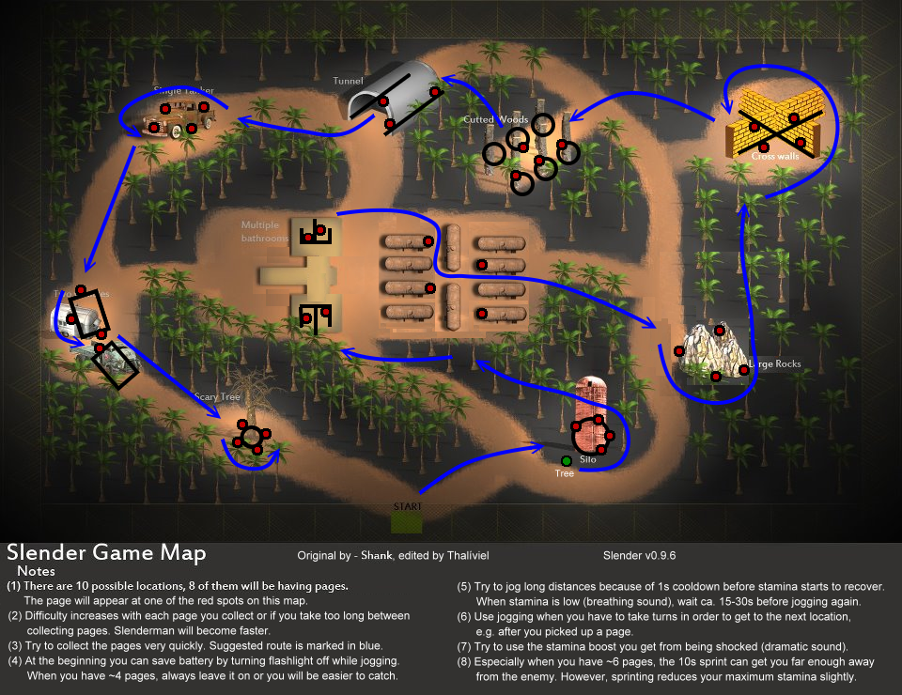
Slender Man
-Clear obvious routes. Although it feels like a cramped decision if you go through the woods.
-visibility of the map is low
-there are a range of cramped spaces, some of which are dead ends which I recommended we don’t have because that will just frustrate the player.
-Random designated drops in the floor plan.
-Clear monuments to help the player locate where they are.
-This is the Original horror indie game that exploded on the market. It does not have a hiding mechanic but it certainly inspired loads of games to add it in so players felt more in control when it came to escaping.

Slide 2
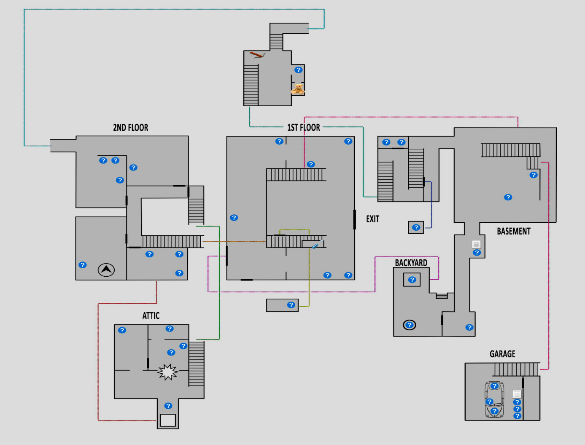
Granny
-Clear obvious routes. Although it feels like a cramped area due to the tight hallways. Room for two people max.
-No dead ends excluding tiny sheds or the garage, but it works because the garage has a loop and there is no need to stay in the tiny sheds for long and the exit is right behind you.
-Random designated drops in the floor plan.
-Clear monuments to help the player locate where they are through the rooms being clearly diegetic and designated to specific themes.
-This game does involve hiding and every room has a hiding spot for security, we should aim to have a counter measure for our game, close by at all times aswell.

Slide 3
OTHER GAMES LACKED FLOORPLANS SO I CREATED NOTES FROM PLAYTEST VIDEOS

Slide 4
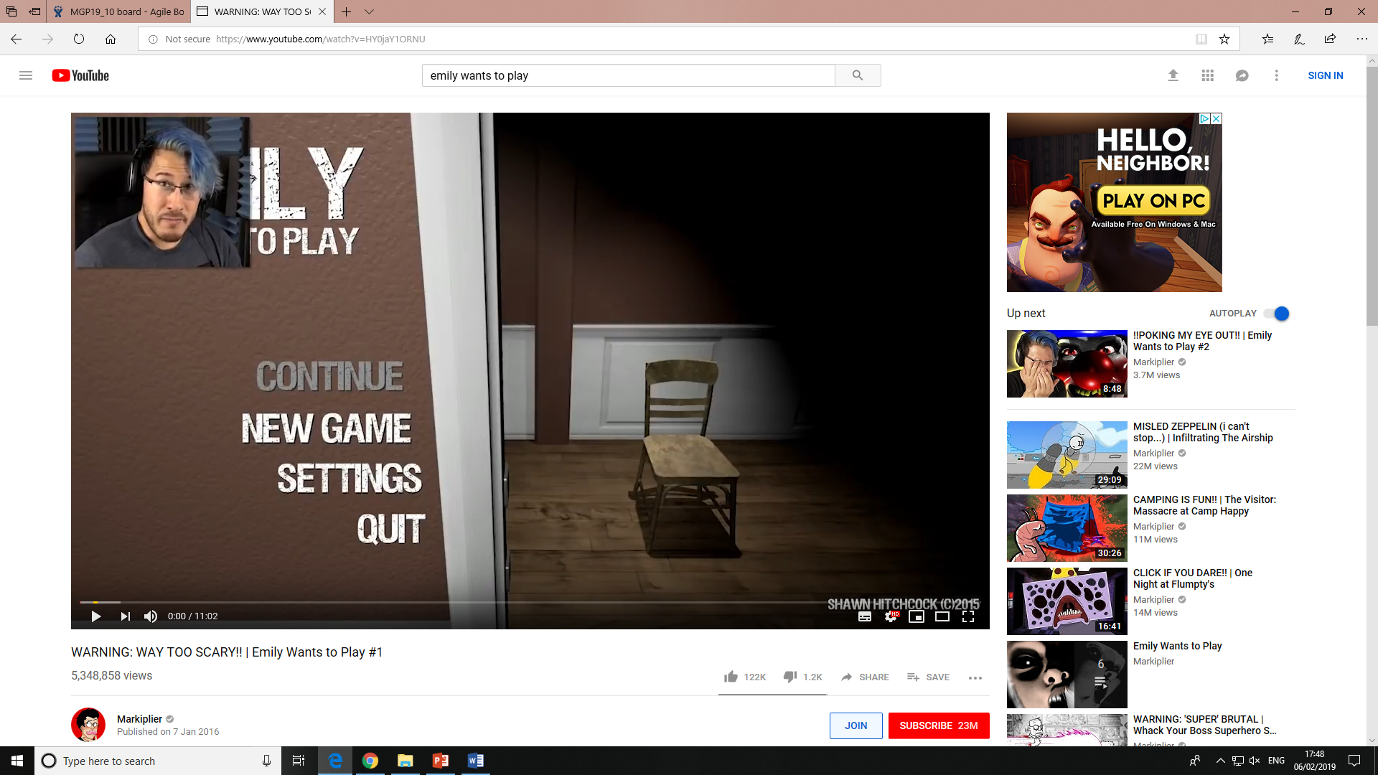
Emily wants to play
-Cluttered spaces. The objects are about knee height so it’s easy for the player to accidently collide into them.
-Paths are a basic box grid of lines essentially.
-The floor plan follows a diegetic theme so it is easy for the player to get a grasp of their location.
-No dead ends unless the exit is right behind you, like an open cupboard.
-It didn’t, but I came to realise if the obstacles created a zig zag player routes, it would require more skill for a get away.
-Doors auto close and restrict space.
-This game has in a way dealt with our brief as the player can’t hide but can interact with the world to stop Emily and friends.
https://www.youtube.com/watch?v=HY0jaY1ORNU

Slide 5

Outlast
-Corridors are large in most areas but the rooms they lead to with the ability to hide are normally open too. This I believe is to create space between the player and their “safe spot”.
-There and no dead ends without a hiding location.
-All routes are clear to the player and as always there are landmarks involved to help the player locate themselves.
-This game also includes the hiding mechanic and was its main focus and selling point from a game mechanic perspective as there was no way to fight back. So in terms of our plan of getting ride of the hde mechanic and enabling the player to give a bit of fight back in their gameplay, makes sense.
My own player feedback.

